Slide 1
STA/BST 222 Survival Analysis Lecture 12
Lihong Qi
Division of Biostatistics
Department of Public Health Sciences
School of Medicine
Nov 10, 2020

Slide 2
How to contact me
Email is best: lhqi@ucdavis.edu
Phone: 530-754-9234
Office hour: email for an appointment

Slide 3
How to contact TA
Xiner Zhou
Email: xezhou@ucdavis.edu
Office hours: 7:00pm – 8:00pm, Thursdays
Lab: 6:10-7:00 pm, Thursdays
For both Lab and OH, please use the zoom link with passcode: survival https://ucdstats.zoom.us/j/9681353237?pwd=ZzhLRHlhNG92bHFUaHkwM0Fib1pqQT09 Meeting ID: 968 135 3237

Slide 4
Focus
Semiparametric proportional hazards (PH) regression

Slide 5
General problems
One sample problem: To test if the sample comes from a population with a prespecified hazard rate h_0(t)
Two samples or more samples: To test if there is no difference in survival between K treatments
Test for trends: are the hazard functions ordered
Stratified tests: adjust for a categorical factor
Modeling: relationship between survival outcomes and covariates of interest, with and without controlling for other factors

Slide 6
Example: WHI Dietary Modification trial
Objective: To examine the long-term influence of the dietary modification intervention on deaths as a result of and after breast cancer during 8.5 years (median) of dietary intervention and cumulatively for all breast cancers diagnosed during 16.1 years (median) of follow-up.
Covariate of interest: dietary modification intervention (yes vs no)
Other covariates: age, BMI, diabetes, race/ethnicity…
Chlebowski RT, Aragaki AK, Anderson GL, Thomson CA, Manson JE, Simon MS, Howard BV, Rohan TE, Snetselar L, Lane D, Barrington W, Vitolins MZ, Womack C, Qi L, Hou L, Thomas F, Prentice RL. Low-Fat Dietary Pattern and Breast Cancer Mortality in the Women's Health Initiative Randomized Controlled Trial. J Clin Oncol. 2017 Sep 1;35(25):2919-2926.

Slide 7
Introduction
Limitations with Kaplan-Meier method
Cannot handle continuous covariates
Cannot adjust for covariates
Cannot directly generate hazard ratio
Potential confounders
Regression techniques to obtain adjusted survival curves.
Semiparametric proportional hazards model
Popular Cox proportional hazards model
Proposed by Cox (1972)

Slide 8
Semiparametric proportional hazards model
Hazard function
A semi-parametric model.
Why?

Slide 9
The Cox PH regression model

Slide 10
Time-independent covariates
h0(t) is baseline hazard and unspecified
Nuisance parameter function
Z: fixed (time-independent) covariates

Slide 11
Characteristics
Log[h(t|Z)/h0(t)]= β₁*z₁+…+β_{p}*z_{p}
Linear model formulation for the covariate effects
Hazard ratio

Slide 12
Characteristics (cont’d)
Proportional hazards (PH): hazard rate is constant over time, so is proportional
E.g. For a binary Z (e.g. treatment)
Interpretation: risk of having the event if one received treatment relative to the risk of having the event if one received placebo
θ=exp(β₁)
Hazard ratio/relative risk: exp(β)
A relative risk measure
>1: increasing risk
<1: decreasing risk

Slide 13
Assumptions of Cox PH model
IID observations
Noninformative/independent censoring
Hazard ratio (HR) is independent of time
Hazard ratio for two Z’s are proportional
An example when the PH assumption is not satisfied
Hazard cross

Slide 14
Notation

Slide 15
Partial likelihood function

Slide 16
Remark
the numerator depends only on information from the individual who experiences the event
the denominator utilizes information about all individuals at risk prior to t_i (who have not yet experienced the event, including some individuals who will be censored later).
Partial likelihood (PL) is not a standard likelihood, but it has (almost) all nice properties of a standard likelihood.

Slide 17
The estimator
Note: no close form for the estimator. Estimator can be obtained numerically, as shown in Appendix A, using a Newton–Raphson technique

Slide 18
Hypothesis testing
Global test:
Three ways:
Wald test
Likelihood ratio
Score test
Information matrix: the negative of the matrix of second derivatives of the log likelihood and is given by (see KM 8.3.4)

Slide 19
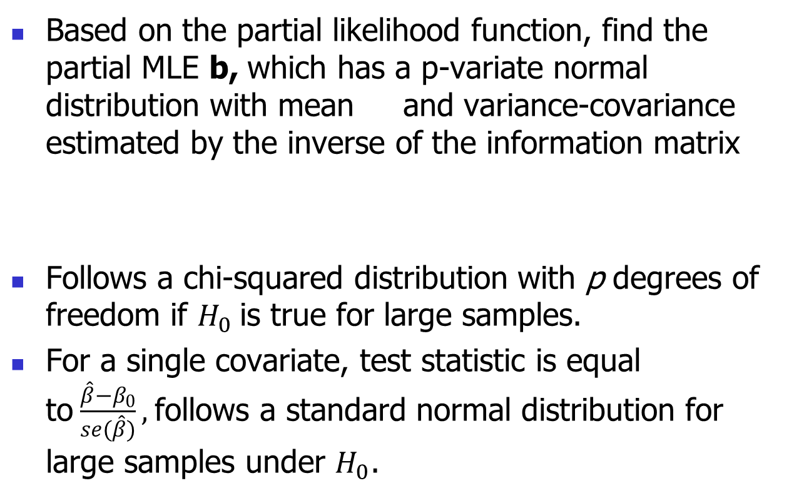
Wald test
Based on the partial likelihood function, find the partial MLE b, which has a p-variate normal distribution with mean and variance-covariance estimated by the inverse of the information matrix
Follows a chi-squared distribution with p degrees of freedom if $H_{0}$is true for large samples.
For a single covariate, test statistic is equal to$\frac{\hat{β}−β_{0}}{se(\hat{β})},$follows a standard normal distribution for large samples under $H_{0}$.

Slide 20
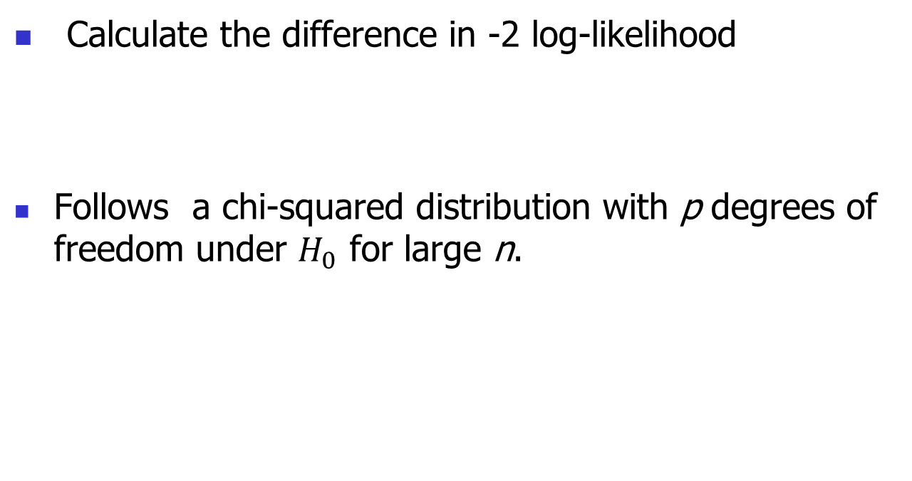
Likelihood ratio test
Calculate the difference in -2 log-likelihood
Follows a chi-squared distribution with p degrees of freedom under $H_{0}$ for large n.

Slide 21
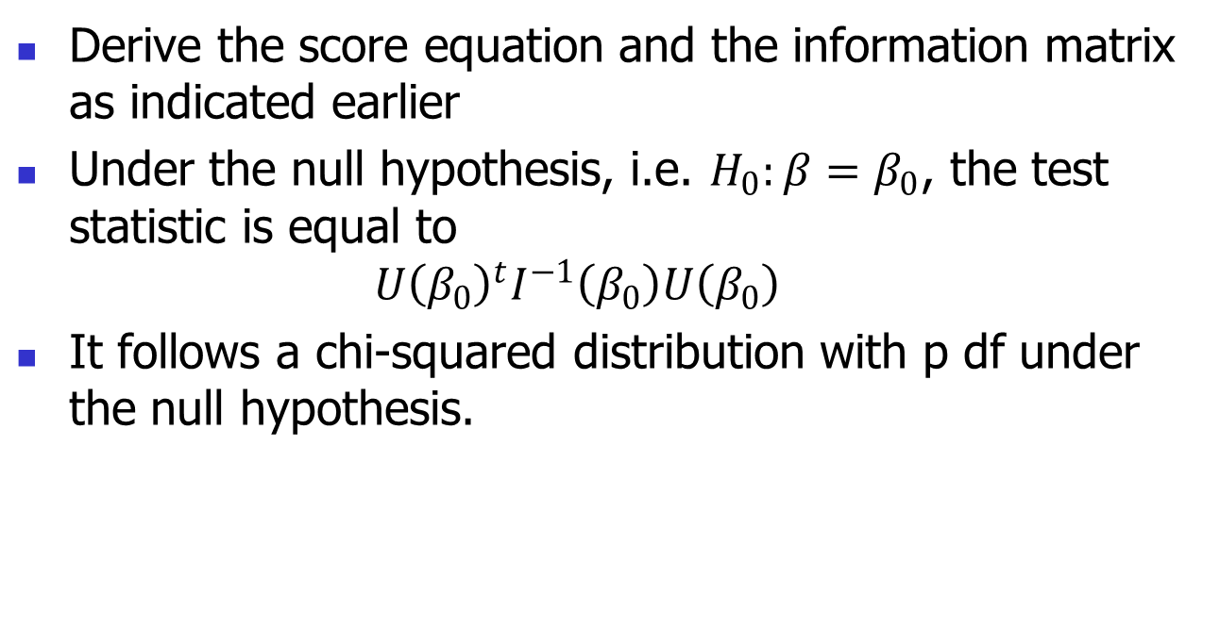
Score test
Derive the score equation and the information matrix as indicated earlier
Under the null hypothesis, i.e. $H_{0}:β=β_{0}$, the test statistic is equal to $U{\left(β_{0}\right)}^{t}I^{−1}\left(β_{0}\right)U\left(β_{0}\right)$
It follows a chi-squared distribution with p df under the null hypothesis.

Slide 22
Example: Breast cancer trial KM 1.5
In section 1.5, we introduced a study designed to determine if female breast-cancer patients, originally classified as lymph node negative by standard light microscopy (SLM), could be more accurately classified by immunohistochemical (IH) examination of their lymph nodes with an anticytokeratin, monoclonal antibody cocktail.
To perform a proportional hazards regression with immunoperoxidase status as the single covariate in the model.
We adopt the usual regression formulation of a dichotomous independent variable and construct a dummy (or indicator) variable as follows.

Slide 23
Example: Breast cancer trial KM 1.5
Binary IHC responses
Positive indicator
What’s the partial likelihood?
What’s the score equation?
What’s the information?

Slide 24
Example: Breast cancer trial KM 1.5
Let Z = 1 if the patient is immunoperoxidase positive, 0 otherwise.
The Cox PH model:

Slide 25
Partial likelihood function

Slide 26
Example: KM 1.5 Partial log-likelihood and score function
The number of deaths in the immunoperoxide positive sample
Y_0i (Y_1i ) is the number of individuals at risk in the immunoperoxidase negative (positive) sample at time t_i .

Slide 27
Example: KM 1.5 Partial log-likelihood and score function

Slide 28
Why Cox PH models are popular?
KM, log-rank test and Cox model are three most popular survival analysis methods.
Semi-parametric property
Will approximate Weibull /exponential if the correct model is Weibull/exponential
Can estimate β without specifying h₀(t)
Can estimate h(t) and S(t) using a minimum of assumptions
Cox PH regression preferred to logistic regression
Survival time and censoring
Hazard ratio/relative risk interpretation

Slide 29
Homework
Reading: KM 8.1-8.3

